Slide 1


Tutorial
Introduction to
connect.ebsco.com

Slide 2
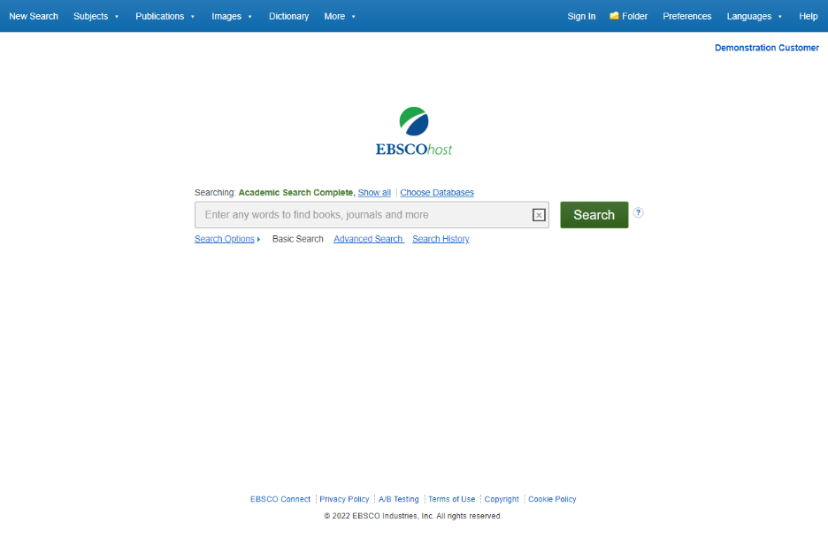
  EBSCOhost is a powerful online reference tool that offers a variety of full text databases and popular databases from leading information providers. In this tutorial, we will look at how to search EBSCOhost, as well as features including: the result list, previewing articles and images, and setting preferences.

Slide 3
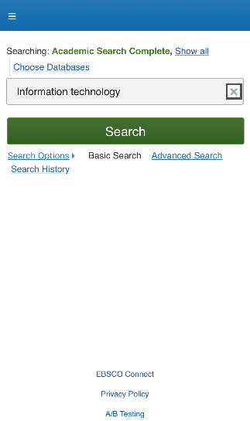
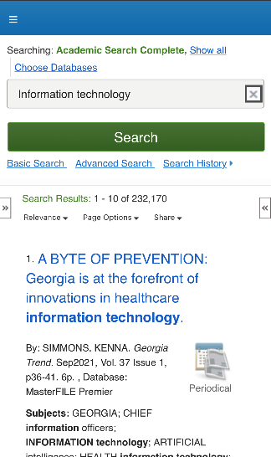
  Note that because EBSCOhost is a fully responsive web experience, you are able to access content from your mobile device with the same features and functionality available to you on desktop computers.

Slide 4
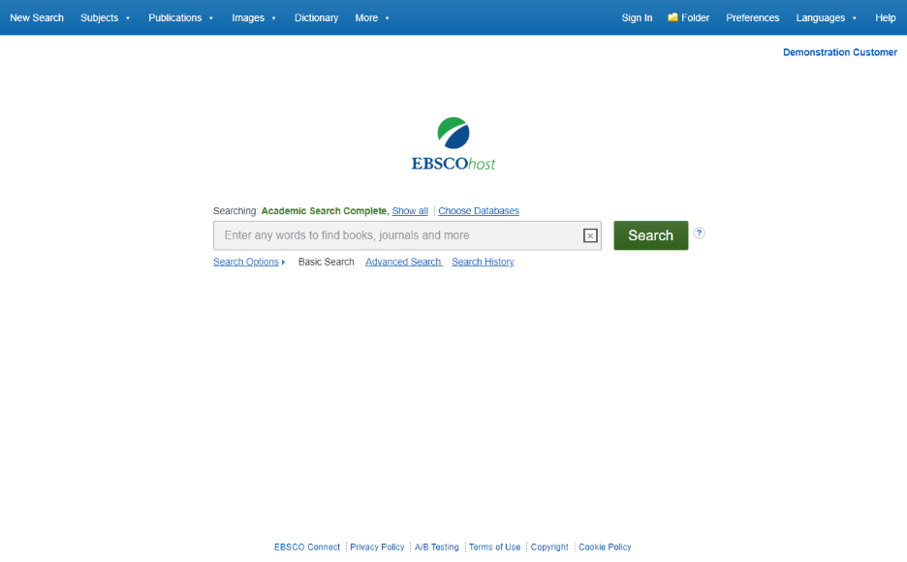
  The Basic Search screen offers a simple, easy-to-use searching experience. The top tool bar offers additional features which can include a publication locator, subject browsing, and image collections. Note that the features available vary based on the databases selected.
  You can add or change the databases being searched by clicking the Choose Databases link.

Slide 5
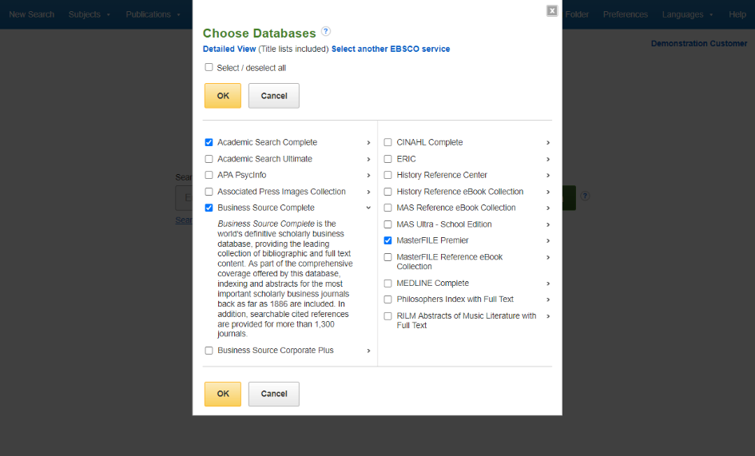
  From here you can read a brief description of all of the databases available to you. When you have located a resource to add, click the checkbox next to the name and click OK.

Slide 6
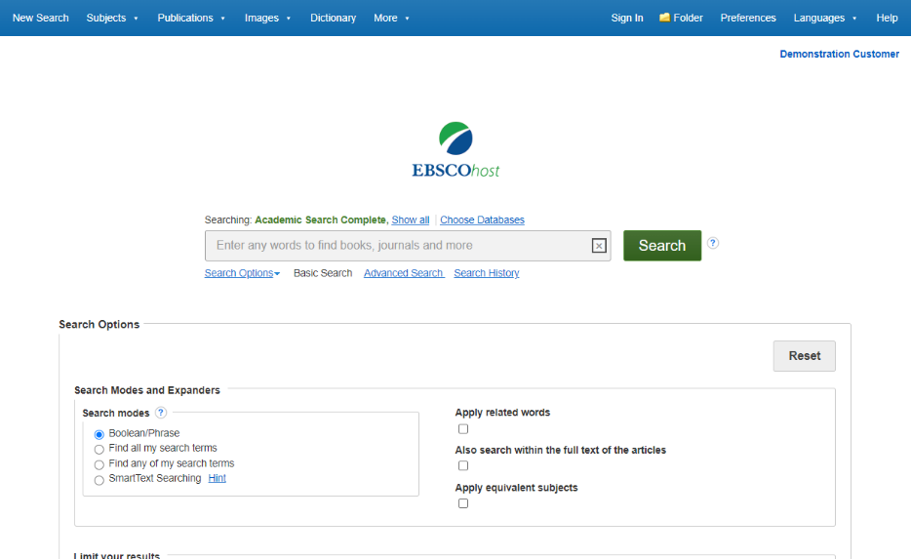
  If you want to create a more targeted search you can expand the Search Options link to display the available limiters. Search modes allow you to choose between the Boolean/Phrase search, which will search for your terms, as you entered them in the search box, Find all of my search terms, which automatically adds an ‘and’ between your terms, or Find any of my search terms, which automatically adds an ‘or’ between your terms.

Slide 7
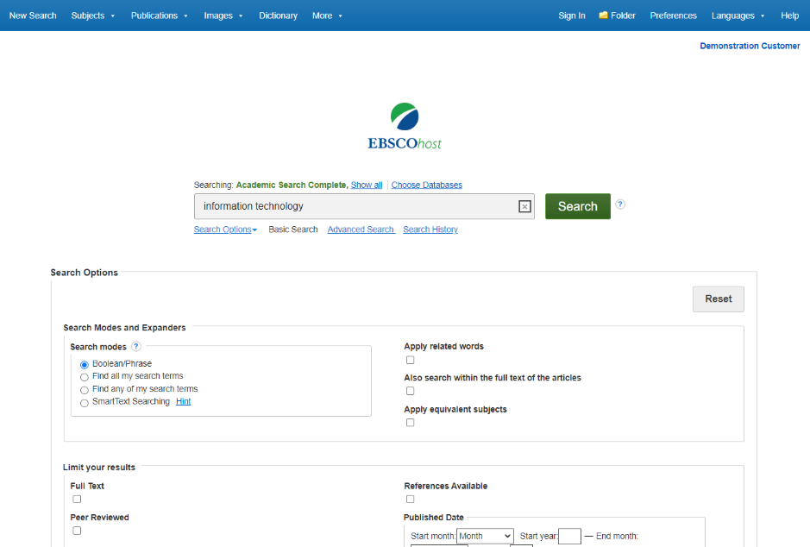
Let’s start with a basic search. Enter the search term in the search box and click Search.

Slide 8
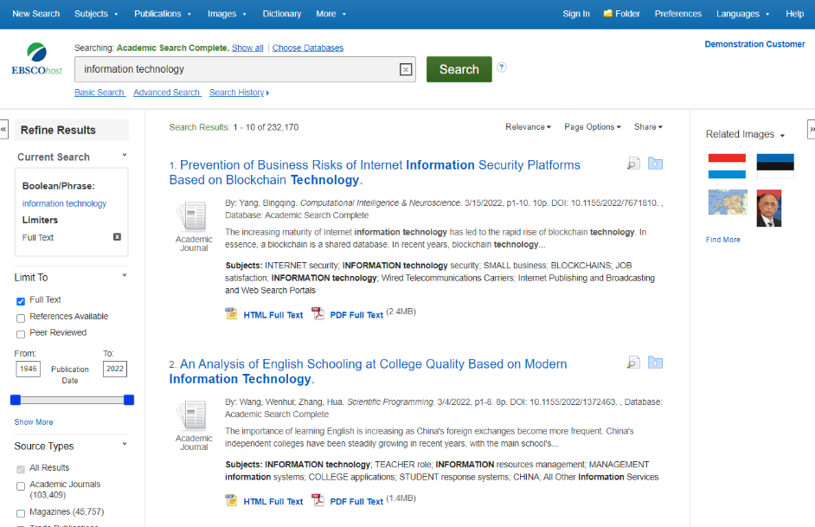
  On the left side of the result list, you can limit your results to articles with Full Text or References Available or use the date slider bar to change the date range of your results. To view all of the available limiters, click the Show More link. When you click on a limiter, the result list is refreshed.

Slide 9
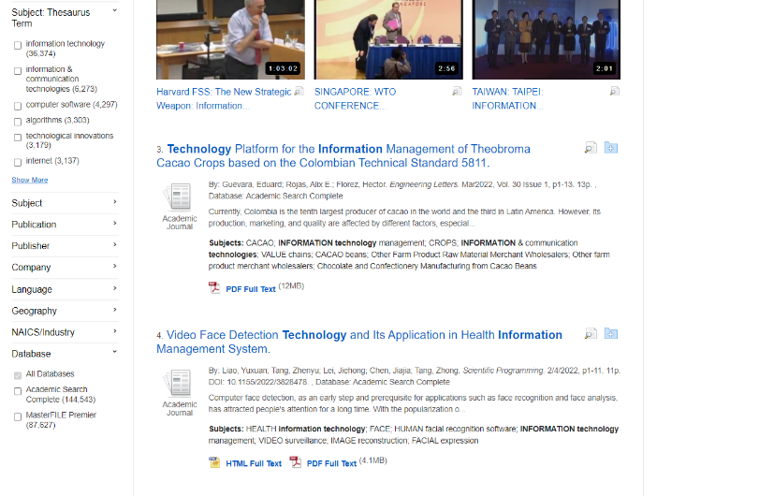
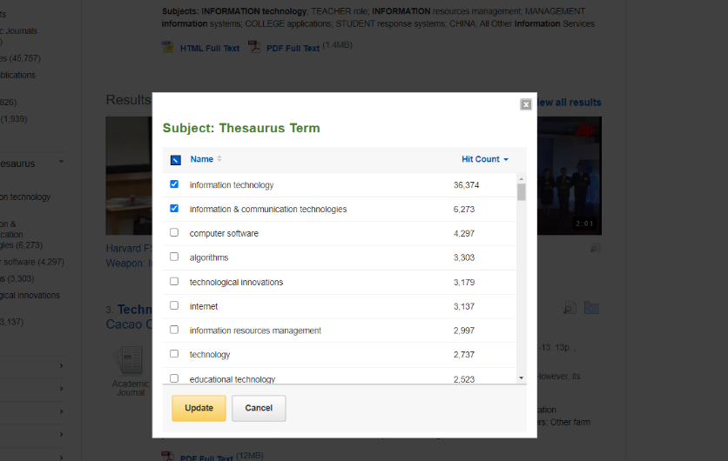
  You can further narrow your results by selecting one or more Source Types, Subjects, Publications, and more. Click a Source Type or Subject Term to update your results. To view all available items, or select multiple terms, click the Show More link. After making your selections, click Update to see your results.

Slide 10
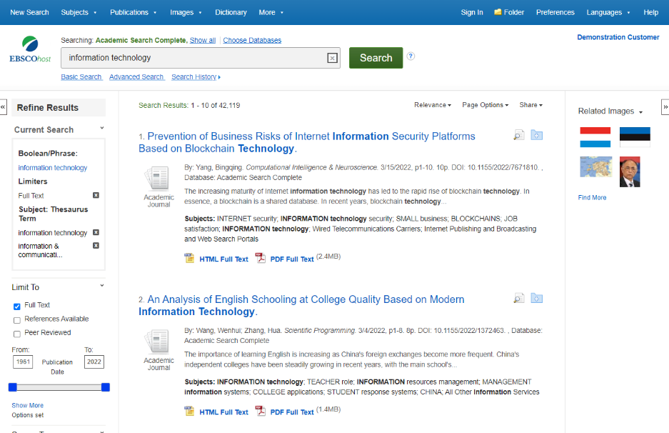
When refining your search results using limiters, source types, and subjects, each item is added to the Current Search box. Use the X icon to remove the item. Clicking on a hyperlinked search term within Current Search performs a search for that term only.

Slide 11
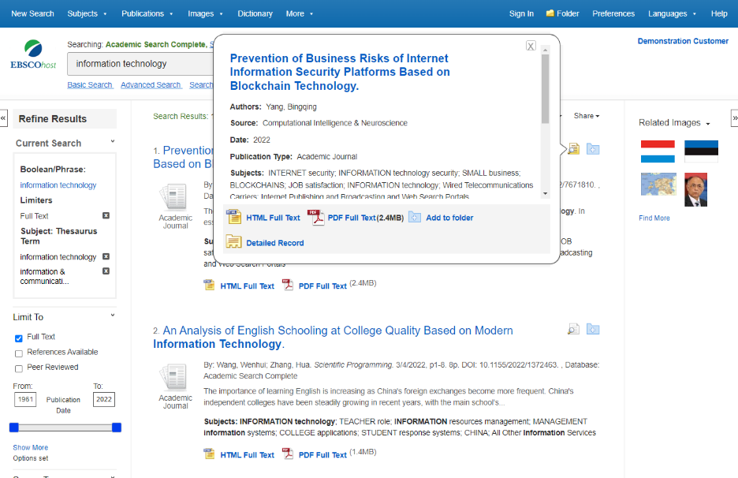
  Preview information about an article by holding your pointer over the magnifying glass icon next to the title. The preview displays additional information about the record, as well as icons linking you to the full text, when available.

Slide 12
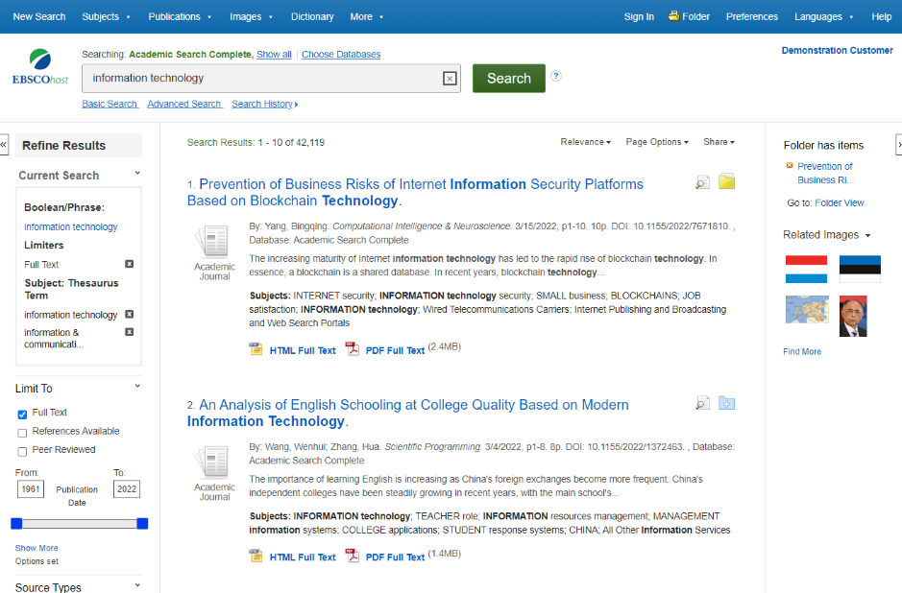
    A folder is available for saving items during your research. Or you can click the Sign In link and create a MyEBSCO folder to store or share your results.

Slide 13
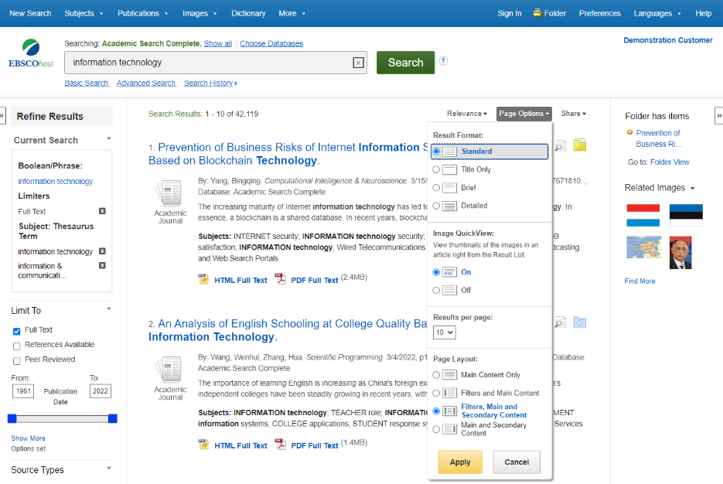
  The Page Options drop-down menu allows you to set your Result Format, turn Image QuickView on or off, set the number of Results per page, and select your preferred Page Layout.

Slide 14
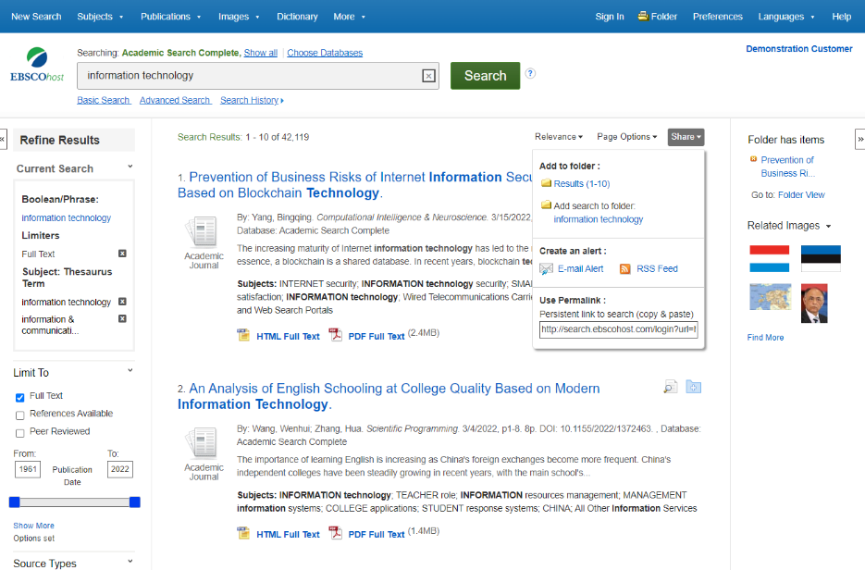
  To save a link to a search in your personal folder, click Share and click the hyperlinked terms under Add search to folder. From this menu, you can also add all displayed results to the folder, create an E-mail Alert, or copy a persistent link to your search

Slide 15
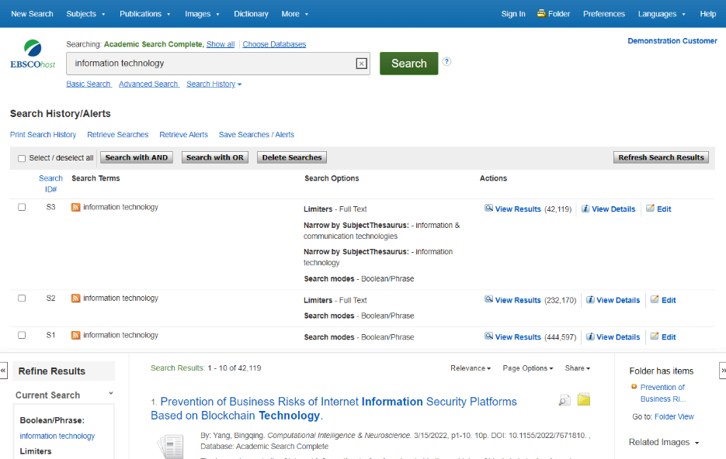
    Click Search History to view the searches conducted during your session. You can also combine searches and add them to the search box by marking the check boxes next to the searches you would like to run and clicking one of the Search with buttons. Click the Edit link to modify the search terms or limiters of that line of your search history.

Slide 16
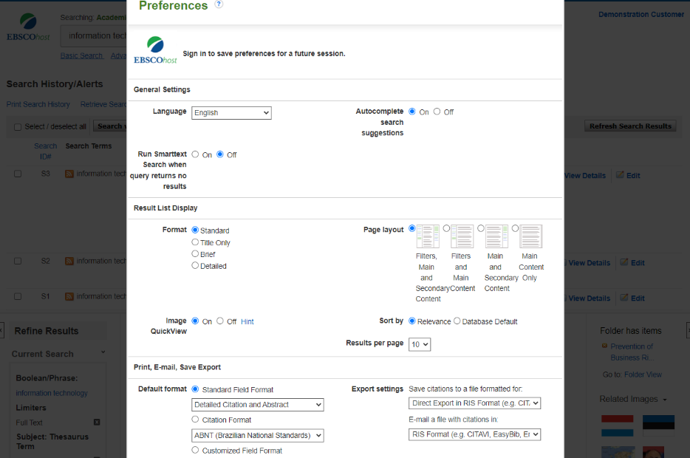
    Click on the Preferences link to select your print, email, save, and export settings, as well as customize options such as page layout and language. You can save your preferences for future sessions by signing into your MyEBSCO folder.

Slide 17
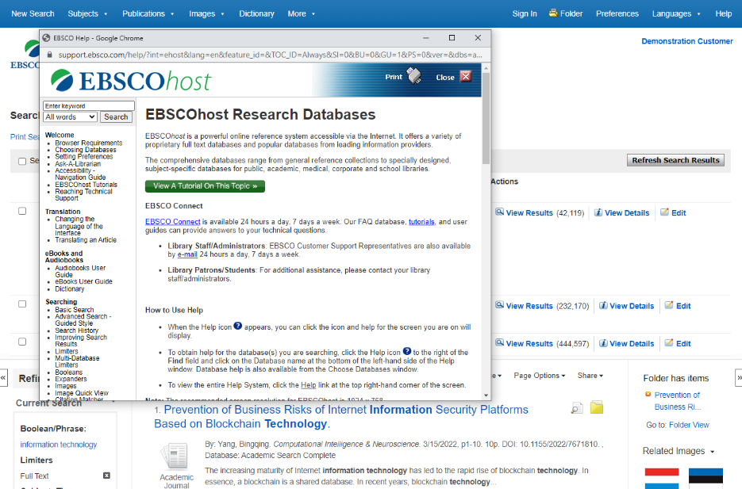
    At any time, click the Help link to view the complete online Help system.

Slide 18


